Slide 1

NETFLIX DATA ANALYSIS
M K KEERTHANA
APPLY_17546600766895fcecdb83b

Slide 2

PROBLEM STATEMENT
Netflix, one of the world’s leading streaming platforms, offers a vast collection of Movies and TV Shows that cater to audiences across different countries, genres, and age groups. With the rapid expansion of global content and increasing competition from other OTT platforms such as Amazon Prime, Disney+, and regional providers, it is essential for Netflix to understand how its content distribution has evolved over time.
The main challenge is to analyze Netflix’s content trends — including the balance between Movies and TV Shows, the popularity of different genres, and the contribution of various countries — to identify key strengths, gaps, and opportunities for strategic content planning.
This project, titled “Netflix Dataset Analysis: Content Trends and Strategic Insights,” aims to uncover how Netflix’s catalog has changed from 2008 to 2021, providing actionable insights into audience preferences, genre dominance, and global content representation.

Slide 3
Project Description
The project “Netflix Dataset Analysis” explores data from Netflix’s Movies and TV Shows to understand content trends across years, genres, and countries. Using Python, Pandas, Matplotlib, and Google Collab, the dataset is cleaned and analyzed to visualize patterns such as the ratio of Movies to TV Shows, top genres, country contributions, and ratings distribution.
The analysis helps identify audience preferences, popular genres, and regional representation, providing strategic insights for Netflix’s content planning and global expansion.

Slide 4

WHO ARE THE END USERS?
Netflix Management and Content Strategists – to make data-driven decisions on content acquisition and production.
Data Analysts and Business Intelligence Teams – to study content trends and audience preferences.
Marketing Teams – to identify popular genres and target regions for promotional campaigns.
Researchers and Students – to understand real-world applications of data analytics in the entertainment industry.

Slide 5

Technology Used
Programming Language: Python
Data Analysis Tools: Pandas, NumPy
Data Visualization: Matplotlib, Seaborn
LLM: ChatGPT
Platform: Google Collab
Presentation Tool: Microsoft PowerPoint

Slide 6
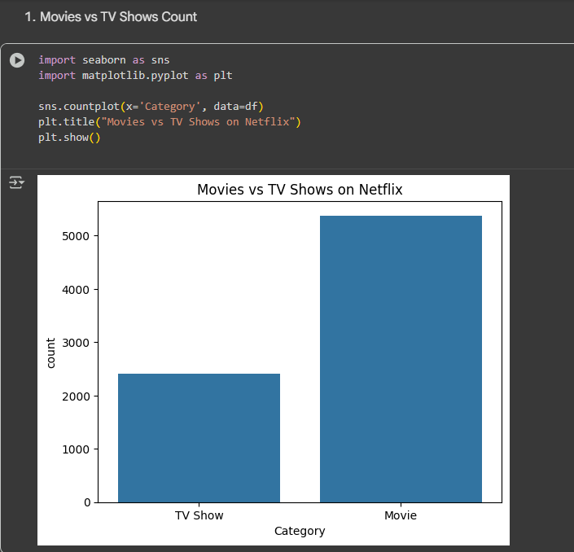
RESULTS1
Movies vs TV Shows Count

Slide 7
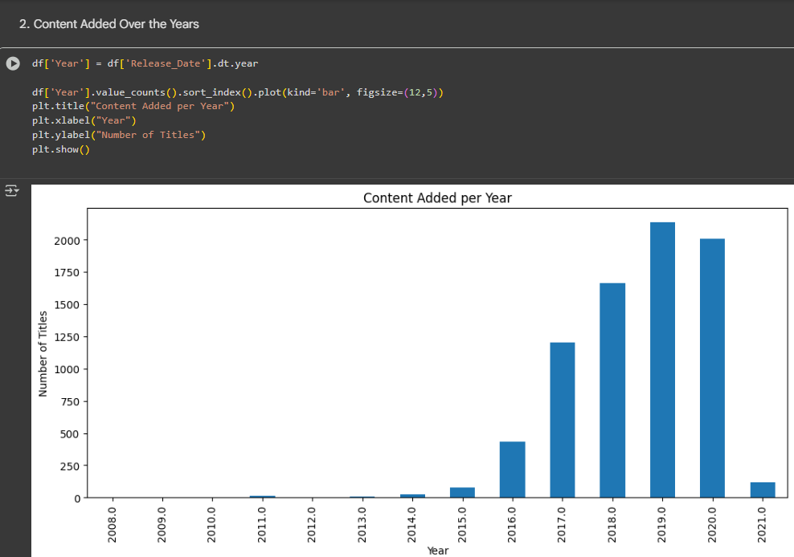
RESULTS2
2) Content Added Over the Years

Slide 8
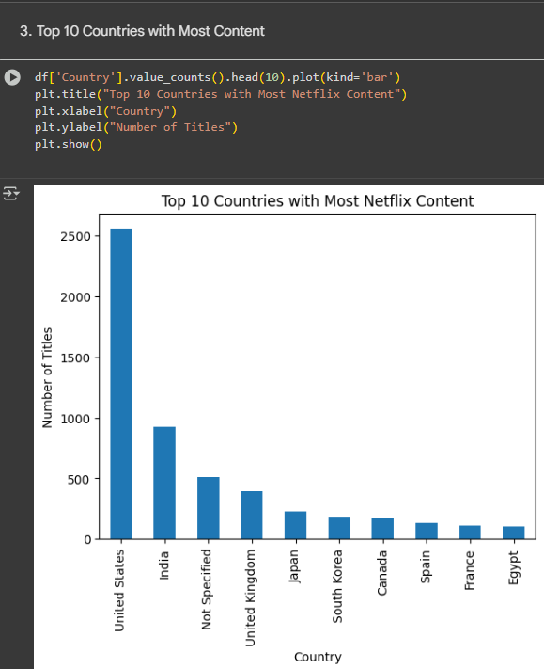
RESULTS3
3) Top 10 Countries with Most Content

Slide 9
GitHub repository
https://github.com/kirtij5/VOIS_AICTE_Oct2025_MajorProject_M.K.Keerthana.git

Slide 10

Getting started with Basics of Python Certificate

Slide 11
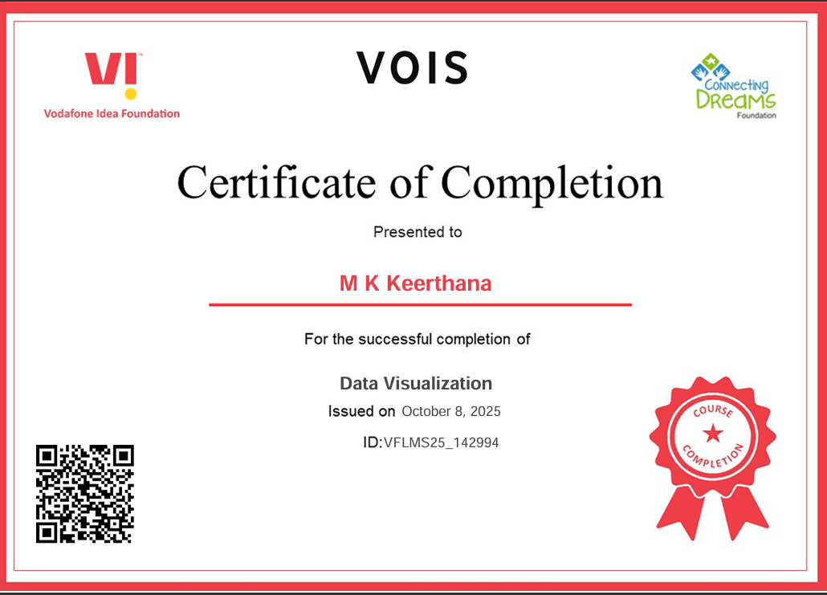
Data Visualization Certificate

Slide 12
Thank you
.
.

